Slide 1
BBB Center for Ethics and Magnified Giving
Notes:
[Teachers to intro on their own. Ex. “Today we’re going to review how the Better Business Bureau (BBB) can help us as we move through the Magnified Giving process.”]
Who knows what the Better Business Bureau does? [BBB (Better Business Bureau) tells the public about businesses that are honest and trustworthy.]
BBB also does that for charities!
BBB works hard to create trust in the business and nonprofit communities. Because of that, people getting into philanthropy — like all of you! — can know just where their time, talent and treasure should go.
You might have heard those words before – it’s a common phrase in the charity sector;.
Do you know what “time, talent and treasure” mean? [The time you put into volunteering; the talent you bring to the table; and the money you give to the cause.]

Slide 2
Charity Accreditation
Standards for Charity Accountability
What do Charity Reports look like?
Looking for Charity Reports
Notes:
Today, we’re going to talk about BBB’s Standards for Charity Accountability,
the four types of reports BBB issues, and
how to search for a charity so you can do your research when you’re ready to give your time, talent, and treasure.

Slide 3
Charity Accreditation
Wise Giving Alliance - since 1920
Why do we do it?
Encourage fair and honest donation practices
Promote ethical conduct
Advance support for philanthropy
Notes:
First – a quick background.
Can anyone guess how long BBB has been around? [Over a century!]
BBB has reviewed charities across the nation for many, many years.
The review process is voluntary. Do you know what that means? [It means it’s not required — there’s no law or anything that says nonprofits have to go through BBB’s review process.]
The review process goes like this: a charity completes an application. BBB goes through all the information on the application, decides whether or not the nonprofit meets Standards, then publishes the results of the review into an easy-to-read online report.
So, how much do you think the review process costs? [It’s completely free! BBB doesn’t think charities should pay for it, and BBB doesn’t charge the public to view the results.]
The Standards BBB uses are considered “best practices” for nonprofits.
Do you know what that phrase means? [When someone says “best practices” they mean a way of doing things that’s generally accepted to be the superior way.]
These best practices, or, Standards, promote high standards of conduct for organizations that ask for donations, and help donors make good giving decisions.
We’ll review the 20 Standards, and then I’ll show you what the reports look like.

Slide 4
Charity Standards
Governance & Oversight
Board Oversight
Board Size
Board Meetings
Board Compensation
Conflict of Interest
Measuring Effectiveness
6. Effectiveness Policy 7. Effectiveness Report
Notes:
Standards 1 through 5 are all about an organization’s structure and accountability.
Every organization should have a Board of Directors. That Board should be active and independent, and Board Members shouldn’t be working for their own best interests. The Board should have oversight of operations and staff, be the right size and meet regularly.
BBB also checks that only a certain percentage of them are paid. Can you guess the percentage? [No more than 10%]
Something BBB also looks out for with Board and with staff: conflicts of interest.
Does anyone know what a conflict of interest is? [A conflict of interest is a situation in which a person is involved in multiple interests — financial, professional or personal — and helping one could hurt another.]
Here’s an example for you: you tell your teacher that your friend is having a bad day, and an extra snack for the whole class would cheer your friend up. Now, an extra snack probably would cheer up your friend — but who really wants the extra snack? [You.]
So you’re using your influence as a friend to get your teacher to give you both something you want, and pretending that you’re just doing it to cheer up your friend.
That’s a conflict of . . .? [Interest.]
Standards 6 and 7 encourage organizations to regularly review their mission and impact, to be sure that there are always defined and measurable goals in place.
What do you think it means to have defined and measurable goals? [It means the organization knows just what they want to accomplish, and can track their progress.]

Slide 5
Charity Standards
Finances
8. Program Expenses 9. Fundraising Expenses 10. Accumulating Funds 11. Audit Report 12. Detailed Expense Breakdown 13. Accurate Expense Reporting 14. Budget Plan
Fundraising & Informational Materials
15. Accurate Materials 16. Annual Report 17. Website Disclosures 18. Donor Privacy 19. Cause Marketing Disclosures 20. Complaints
Notes:
Standards 8 through 14 go into the financial stuff. BBB looks at statements from the IRS and CPAs, as well as a current operating budget. Through this set of Standards, BBB makes sure the charity is spending its funds honestly and cautiously, and that it lines up with what they say the money is for when they fundraise.
You’ll encounter financial information when you review grant applications. This set of Standards can help you understand more about what you’re looking at - and what to look for.
We’re going to talk a little more about the financial standards:
Standard 8 reviews how much a charity spends on its programs.
BBB asks nonprofits to spend a certain percentage of their total expenses on programming — can you guess it? [At least 65%.]
Standard 9 checks the amount they spent on fundraising, and divides that by their contributions income.
Who knows where contributions can come from? [Donations, grants, events like a 5k or concert, etc.]
The next one is Standard 10. BBB doesn’t want charities to hold money forever that could be used now, so this one’s all about unrestricted net assets – that’s money that the nonprofit has that doesn’t already have somewhere to go.
Here’s an example of that. One kid gives $10 to, let’s say, a fish nonprofit, and doesn’t tell them exactly what to do with it – that’s unrestricted. Another kid gives $10 to the fish nonprofit, and tells them they can only use it for goldfish training – that’s restricted. So, after these two kids have donated, the fish charity has $20 in assets. How much of it is unrestricted? [$10.]
When it comes time to give your donation through Magnified Giving, you may have the option to designate which program the charity operates will receive the funds. If you do this, that is a restricted donation - the charity can only use the money you give for that specific purpose.
Standard 11 has certain levels built in for the types of financial statements that BBB needs to review – the government requires a specific form, and we ask them to have other forms depending on their revenue.
What’s revenue? [How much money they bring in.]
Standard 12 requires a specific document be present in the organization’s financial statements. It’s called a Statement of Functional Expenses, and without this the charity doesn’t meet the Standard.
Any guess as to what a Statement of Functional Expenses is? [It basically says where they spent their money.]
Standard 13 looks at the accuracy and transparency within the financial statements the organization provided.
Accuracy meaning . . . ? [Everything’s correct.]
Transparency meaning . . . ? [Everything’s upfront and open.]
Standard 14 asks the charity to have a budget, to confirm they have a plan for spending this year. You may also get the chance to review a charity’s budget when you’re reviewing their grant application.
Finally, Standards 15 through 20 deal with how a nonprofit represents itself to the public. This means checking fundraising appeals, annual reports and websites to be sure that the charity is presenting itself accurately, completely and respectfully. And of course, the charity is expected to respond promptly to any complaints made to BBB.
Any questions on the Standards?
Now, let’s look at the information you’ll see when you look at a BBB Charity Report.

Slide 6
Notes:
One more time . . . the review process goes like this: a charity completes an application. BBB goes through all the information on the application, decides whether or not the nonprofit meets Standards, then publishes the results of the review into an easy-to-read online report.
So, when a nonprofit sends in an application and checks out their review, they’ll see one of three things for each of the 20 Standards.
A green check mark means the Standard was met.
A yellow x means the Standard was not met.
A blue question mark means the information about the Standard couldn’t be confirmed.
Quick quiz:
what does a green check mark mean? [The Standard was met.]
What does a yellow x mean? [The Standard was not met.]
And a blue question mark? [The necessary information couldn’t be confirmed.]
Now, we’ll look at some reports to show you examples.

Slide 7
CHARITY NAME
Phone Number
Street Address
Website
Notes:
What do you think happens if a charity meets all 20 Standards? [They earn Accredited Charity status.]
This status is displayed on their BBB Charity Report so that people can easily see that they meet all 20 Standards.
You’ll also see in the box below contact information that there are 20 green check marks, meaning 20 met Standards.
There is a section below this box with tabs of information. The first tab shows the Conclusions of the review – and that this charity meets the 20 Standards for Charity Accountability.

Slide 8
CHARITY NAME
Phone Number
Street Address
Website
Notes:
If a charity does not meet all Standards, it will say that on the top of their report, along with which standards are not met or verified. That information will also be in the box below contact information, and in the Conclusions section, with more details.

Slide 9
Notes:
For this charity, we can see that it’s not meeting two Standards.
Which Standards are those? [Standard 13 and Standard 16.]
As you can see, BBB lists the Standard, and what exactly was missing or caused the charity to not meet the Standard.
By the way, to figure out which Standards are being met, BBB always uses the documents and information given by the charity. BBB does not use information about a nonprofit without their permission.
Below the two standards not met, BBB lists those that weren’t able to be verified. Sometimes, a report that says “Standards Not Met” means more that BBB wasn’t able to verify information it was given. That’s why it’s good to keep in mind that finding a report that says “Standards Not Met” isn’t necessarily a bad thing at all!
BBB is simply giving important information to the public – you – in as clear a way as possible, based on the 20 Standards. BBB doesn’t go by opinions . . . only facts, and facts that can be verified.

Slide 10
CHARITY NAME
Phone Number
Street Address
Website
Notes:
The other type of charity report BBB issues is a Did Not Disclose report.
Are you familiar with the word disclose? [It means to make some information known.]
So, a Did Not Disclose report simply means that the nonprofit in question disclosed no information to BBB.
As mentioned earlier, the program is voluntary, which means BBB won’t publish anything at all unless the charity gives it to BBB to do so.
A charity can have a Did Not Disclose report for a number of reasons. They may not have responded to the request to participate - maybe they changed their address and BBB wasn’t told about the change. They may have chosen to not participate because they didn’t have time. Or they had other priorities that got in the way of submitting information.
As we talked about earlier, participating in BBB’s process is voluntary - charities do not have to provide information for whatever reason they choose. But remember, just because they have a Did Not Disclose report doesn’t mean the charity is not doing good work and is not worthy of your time to research and ask questions.

Slide 11
Notes:
BBB also issues Informational Reports, which are for organizations that haven’t received any inquiries in their system.
Who knows what an inquiry is? [An inquiry is when someone reaches out and asks about an organization.]
There are some organizations that BBB can’t review. BBB can only review 501(c)3 charities – 501(c)3 organizations have a special tax designation that allows them to accept tax deductible contributions. This means that if you donate to them, you can write it off on your taxes.
Those are the only nonprofits BBB can review. As you know, though, there are so many other types of nonprofits. So, BBB issues Informational Reports about all the organizations not able to be reviewed, just to let the public know BBB is aware of them.
One example is up here on the screen. The Lebanon Optimist Club is a 501(c)4 social welfare club and can’t accept tax deductible charitable contributions. BBB has contact information for this organization, and then a note that says what type of nonprofit they are – 501(c)4 – and that they’re not eligible for BBB’s review program.
Quick recap:
BBB can only review what kind of nonprofit? [501(c)3.]
What kind of report does BBB put out for those organizations that aren’t 501(c)3? [Informational Reports.]
Let’s talk about the rest of the report.

Slide 12
Notes:
In the tabs below the Standards summary, there’s information about the charity that comes from the application submitted, along with financial statements, website and annual reports.
The Conclusions section shows if the charity meets all 20 Standards. If not, this is where those Standards not met are listed, and why they’re not met.

Slide 13
Notes:
The Purpose tab gives the charity’s mission statement, and when they were incorporated in the state.
If the charity has any alternate names, those are listed here too.

Slide 14
Notes:
The Programs tab has a description of the nonprofit’s work, and, if applicable, specific program expenses so donors can see how much is spent in what areas.

Slide 15
Notes:
The Governance & Staff tab lists the names of the Board Chair and chief executive, and the size of the board and staff.

Slide 16
Notes:
In the Fundraising tab, the types of fundraising the charity reported doing in the last year are listed, along with the percentage of related contributions spent on fundraising.

Slide 17
Notes:
In the Tax Status tab, it’s confirmed that the charity is a 501c3 charity with the government, and is eligible to receive tax deductible charitable contributions.

Slide 18
Notes:
In the Financial tab, BBB tells the public where the charity’s money came from and what it was spent on. This is where you’ll find the specific percentages of how their money was spent on programming, as well as asset and liability information.
Some reports will have the BBB Comment tab. That’s for additional locations, or any other notes BBB needs to share.

Slide 19
How to look up Charity Reports
Notes:
Alright. So we’ve covered the Standards and what a report looks like – now let’s see what it looks like when you search for a charity with BBB.
BBB recommends using give.org when researching charities.

Slide 20
Notes:
When you search for a charity by name at give.org, this list of relevant results will come up. Just click to view a report.

Slide 21
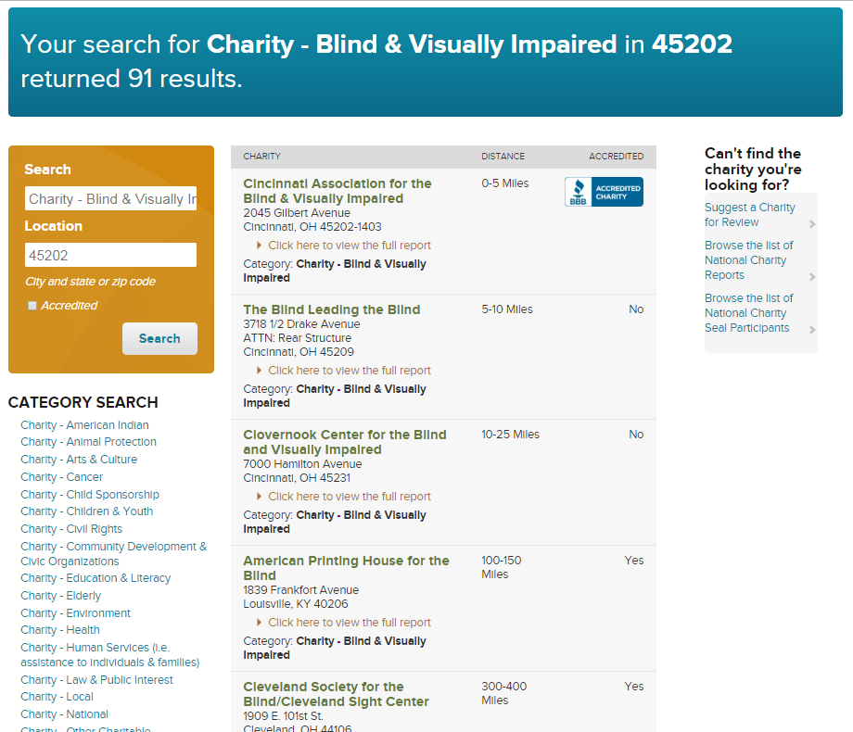
Notes:
You could also search by charity type from the list on the left side.
Using key terms and a zip code, you could get a list of all of those kinds of charities, starting with those closest to the zip code you entered.
What kinds of key terms could you search for? [Animal Protection, Environment, Children & Youth, Religious, etc.]
Up here, you can see a search was done for “Charity - Blind and Visually Impaired” using the zip code for downtown Cincinnati – 45202. The results come up and give us a list of any charity that has that term associated with it.
Starting closest to the zip code and working out, you can see the search resulted in three cincinnati charities.
Where are those 3 located? [Cincinnati, Louisville and Cleveland.]
Remember - participating in BBB’s process is voluntary - charities do not have to provide information for whatever reason they choose. But remember, just because they don’t have a report, or they might have a Did Not Disclose report, doesn’t mean the charity is not doing good work and is not worthy of your time to research and ask questions.

Slide 22
Wrap Up
Standards for Charity Accountability
Charity Report information
Searching for Charity Reports
Notes:
That just about covers what BBB wanted to share with you. Please remember that some of the work you’re doing when researching charities has been done for you! BBB wants you to research on your own, using the tools Magnified Giving gives you – but don’t forget to use BBB to supplement those materials.

